Slide 1
WEBINAR Nanotechnology Risk Management via Certification of Occupational, Environmental Health and Safety Programs – a Due Diligence Approach

Slide 2
Purpose of U.S. – E.U. Partnering
Who: NanoEHS scientists and practitioners from the U.S. and EU
What: A platform for scientists to develop a shared repertoire of protocols and methods to overcome research gaps and barriers and to enhance their professional relationships
Where: Video- and/or teleconferences and annual workshops
Why: To address environmental, health, and safety questions about nanomaterials and to collaboratively advance the field
How: The communities will be largely self-run with the EC and the U.S. National Nanotechnology Coordination Office providing administrative support.
http://us-eu.org/

Slide 3
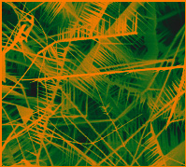
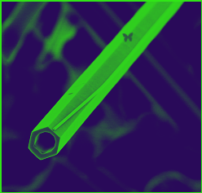
Communities of Research for NanoEHS
(CORs)
groups of people: US-EU scientists and practitioners
share a significant interest: nanoEHS
develop a shared repertoire of resources: experiences, tools, ways of addressing recurring questions and challenges
regular contact: use wikis, webcasts, conference calls, annual US-EU meeting.
Notes:
Based on Model of Communities of Practice
formed by groups of people
share a significant interest in a topic and interact regularly to advance that interest,
develop a shared repertoire of resources: experiences, tools, ways of addressing recurring problems—in short a shared practice
do not necessarily work together on a daily basis.
The Impressionists, for instance, used to meet in cafes and studios to discuss the style of painting they were inventing together. These interactions were essential to making them a community of practice even though they often painted alone

Slide 4
Communities of Research for NanoEHS
Exposure through the Life Cycle
Ecotoxicity Testing and Predictive Models
Predictive Modeling for Human Health
Databases and Ontologies
Risk Assessment
Risk Management and Control Measures

Slide 5
CoR6: Nanosafety Risk Management and Controls
The focus of the Community of Research for Risk Management and Controls is to engage scientists and nanosafety professionals in identifying and sharing methodologies, control strategies and demonstrated effective solutions for the common purpose of reducing and preventing adverse health, safety and environmental exposures to nanomaterials. Through participation in active exchange of interested and knowledgeable scientists and professionals, development of best practices can emerge that can be widely shared. Also, the CoR will identify specific research needs to improve risk management decision-making where gaps are found in the fundamental risk management variables.
CoR6 Co-Chairs:
Larry Gibbs, Stanford University
Tom Van Teunenbroek, Ministry of Infrastructure and Environment, The Netherlands

Slide 6
Nanotechnology Risk Management via Certification of Occupational, Environmental Health and Safety Programs – a Due Diligence Approach
Presenters:
Ilise L Feitshans JD and ScM Visiting Scientist – Institute for Work and Health, University of Lausanne vaud Switzerland and Doctoral candidate “Forecasting Nanolaw” Geneva School of Diplomacy
Don Ewert, Vice President – Field Services; nanoTox, Inc.

Slide 7
Nanotechnology Risk Management via Certification of Occupational, Environmental Health and Safety Programs – a Due Diligence Approach
Webinar Discussion

Slide 8
2013 U.S.-EU NanoEHS Workshop Decmber 2-3, 2013 Arlington, VA
www.us-eu.org

