Slide 1



Nano-Cipher Activity
October 11th & 12th, 2018
Brought to you in part by the Risk Assessment Community of Research
Dr. Janeck Scott-Fordsmand
Senior Scientist, Department of Bioscience
Dr. Christine Ogilvie Hendren
Assistant Research Professor, Duke University
Executive Director, Center for the Environmental Implications of NanoTechnology

Slide 2
Nano-Cipher Activity Motivation
Promote clear communication for words key to understand each other regarding nanoEHS research:
  Regarding work across the past 10-15 years
  Regarding where nanoEHS research needs to go across the next 5-10 years
Illuminate assumptions, differences, and shared meanings
Explore epistemic humility
Risk Assessment
Exposure Throughout the Lifecycle
Risk Management and Control
Characterization
Nanomedicine
Databases and Computational Modeling
EcoToxicity
Human Toxicity

Slide 3
Exploring Epistemic Humility
Two experts might be using the same word with different understood meanings
They may or may not realize this
If that is happening:
  Both could be valid
  Both could be less than fruitful
  One could be “more” correct for a particular context
  Context can open flow of understanding
  Perhaps there are patterns in how communities and geographic regions think about concepts of shared relevance
“Sometimes we don’t know when we’re talking past each other”
~ Rick Canady, yesterday

Slide 4
Perspective Anamorphosis

Slide 5
Emulsifer, by Thomas Medicus

Slide 6
Emulsifer, by Thomas Medicus

Slide 7
Emulsifer, by Thomas Medicus

Slide 8
Emulsifer, by Thomas Medicus

Slide 9
Emulsifer, by Thomas Medicus

Slide 10
Emulsifer, by Thomas Medicus

Slide 11
Thinker
by Jonty Hurtwitz

Slide 12
Thinker
by Jonty Hurtwitz

Slide 13
Thinker
by Jonty Hurtwitz

Slide 14
How this works
Attend COR Breakout Session
For each of the 5 words, enter two lines describing what the words mean to them into the appropriate googledoc (emailed to COR co-chairs).
If interested, can then share between combined COR to look for differences, similarities
Closing Nano-Cipher session will share, compare, and discuss

Slide 15
How this works

Slide 16
Possible Words
Exposure!
Dose?
Model?
Environmentally relevant?
Read-across?
Primary particle?
Relevant across multiple COR domains
Ripe for disconnects
Bee in your bonnet

Slide 17
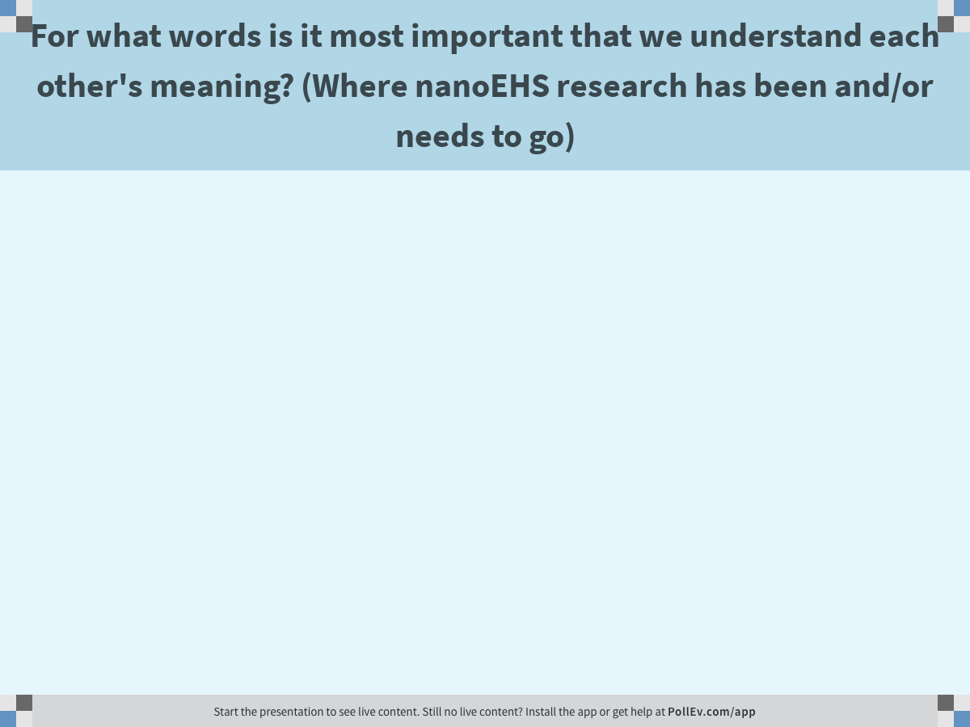
Notes:
For what words is it most important that we understand each other's meaning? (Where nanoEHS research has been and/or needs to go)
https://www.polleverywhere.com/free_text_polls/kB923zVwSATuWj0

