Slide 1
Defining the Relationships Between Communities of Research
A potential approach proposed
by the Risk Assessment CoR
Christine O. Hendren and Mark Hoover
www.ceint.duke.edu

Slide 2
Proposed Graphical Representations of the US-EU Communities of Research: An Information-to-Action Continuum
The following graphics are intended to illustrate how the CoRs can ideally link and feed one another through an idealized information-to-action continuum.
Although a number of simplifications are in play, notably the role of "ontologies and databases" as the supporting and unifying foundation of an "information pyramid”, it is hoped that these images of the proposed continuum will help clarify and guide the cohesive development and implementation of comprehensive and effective CoR activities.
The proposed graphics were created, in particular, to help define the role of the Risk Assessment CoR. Using the concept that “exposure x hazard = risk”, the Risk Assessment CoR is working to determine the best ways to organize and analyze exposure and hazard data to create meaningful risk forecasts that will support sound decision-making.

Slide 3
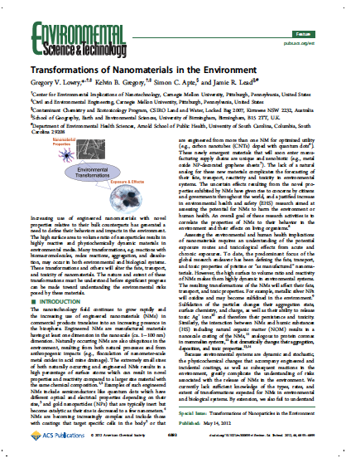
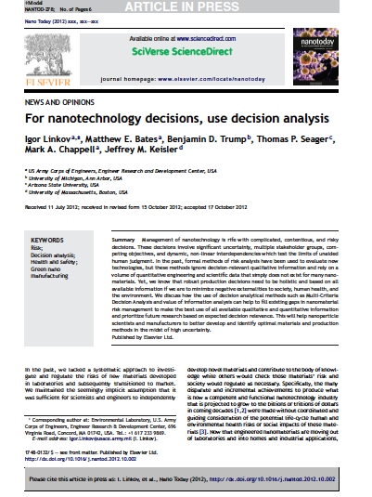
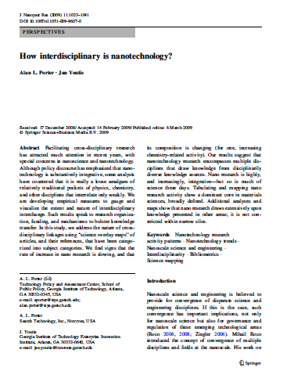
Idealized Information-to-Action Continuum
Action
Use risk assessment input to weigh trade-offs in context of alternatives and take action to minimize risks.
Risk Management CoR
Synthesize hazard and exposure research, filter and interpret to arrive at risk forecasts of ENMs.
Risk Assessment CoR
Draw on emerging and increasingly organized data sources to model potential exposure, transformation, biouptake, and ecological and human health impacts.
Exposure Modeling CoR
Ecotox Testing and Modeling CoR
Human Health Modeling
CoR
Subsume and organize all emerging nanomaterial data and metadata to provide hazard and exposure modelers with rich, integrated data sets.
Ontologies and Databases CoR
Information
Open Literature

Slide 4
Idealized Information-to-Action Continuum: How it supports exposure x hazard = risk
Action
Use risk assessment input to weigh trade-offs in context of alternatives and take action to minimize risks.
Risk Management CoR
Synthesize hazard and exposure research, filter and interpret to arrive at risk forecasts of ENMs.
Risk Assessment CoR
Risk
=
Draw on emerging and increasingly organized data sources to model potential exposure, transformation, biouptake, and ecological and human health impacts.
Exposure Modeling CoR
Ecotox Testing and Modeling CoR
Human Health Modeling
CoR
Exposure
X
Hazard
Subsume and organize all emerging nanomaterial data and metadata to provide hazard and exposure modelers with rich, integrated data sets.
Ontologies and Databases CoR
Information
Open Literature

Slide 5
Current Information-to-Action Continuum
Action
The current horizontal information-to-action continuum fails to efficiently organize and deliver emerging nanotechnology data and information among the CoRs.
Implementation of the idealized information-to- action continuum will optimize CoR roles and communication pathways to:
support the development of relevant models of exposure and hazard potential ,
synthesize exposure and hazard potentials into assessments of risk, and
translate the results of assessments into effective decision-making for risk management .
Risk Management CoR
Risk Assessment CoR
Exposure Modeling CoR
Ecotox Testing and Modeling CoR
Human Health Modeling
CoR
Information
Ontologies and Databases CoR
Open Literature

