Slide 1





Risk Assessment
Communities of Research (CoR)
Scope
Sharing of knowledge and expertise to harmonize and synthesize research on methods and practices for analyzing risks for human health and the environment associated with exposure to nano-enabled products along the value chain
Organization
  CoR chair team (EU: Derk Brouwer (TNO); US: Mark Wiesner/Christine Hendren (Duke Univ)) and ~ 25 active members
  Focus groups associated with the nine objectives that have been identified
Presenter: Teresa F Fernandes, HWU, Edinburgh, UK

Slide 2
CoR RA objectives
Objectives
Coordinate with the Ontologies and Databases CoR on terminology and resources that enable inputs from the Ecotoxicology Testing & Predictive Models CoR, the Predictive Modeling for Human Health CoR, and the Exposure through the Life Cycle CoR to be meaningfully analyzed by methods from the Risk and Benefit Assessment CoR in a manner that supports informed decision-making by the Risk Management & Control CoR,
Inventory methods and tools available for assessing and comparing potential risks and benefits (including applications such as medical diagnostics and treatment),
Match tools with end-user mission and decision needs,
4. Identify gaps among tools, data, stakeholder missions, and management need,
5. Review data to assess underlying physicochemical parameters and environmental conditions that can be used as predictors of nanomaterials risks and benefits,
6. Compare risks associated with engineered nanomaterials with those presented by incidental and naturally occurring nanomaterials and evaluate associated uncertainty,
7. Recommend a framework for including considerations of health and environmental impacts in planning and decision-making for the production, use, and disposal/recycling of nanomaterials and nano-enabled products,
8. Recommend methods for calculating risks and benefits that allow for the ability to assess associated uncertainty as well as adapt and update risk estimates as new information becomes available or as stakeholder mission and decision needs change, and
9. Identify steps forward required to produce comparable risk and benefit calculations within a defined context or mission.

Slide 3
Activities so far
US-EU nanoEHS workshop Helsinki 2012
Several (telecon) target groups and joint CoR meetings with regard to objectives, work progress and coordination
Topical presentations at telecons
Exchanges on EU (NSC) and US (NRC) nano-EHS strategies with a focus on research areas with high priority gaps

Slide 4
Risk Assessment CoR Activities 2012-2013
Compiled spreadsheet of existing nano risk assessment resources, evaluating tools in terms of whether they meet certain objectives or present particular opportunities.
  Coordination with other CoRs
  Survey of methods and tools
  Matches tools with needs
  Identifies gaps
  Identifies which physical chemical properties and conditions act as risk predictors
  Compares risk
  Recommends framework for planning and decision-making
  Recommends methods for calculating risk

Slide 5

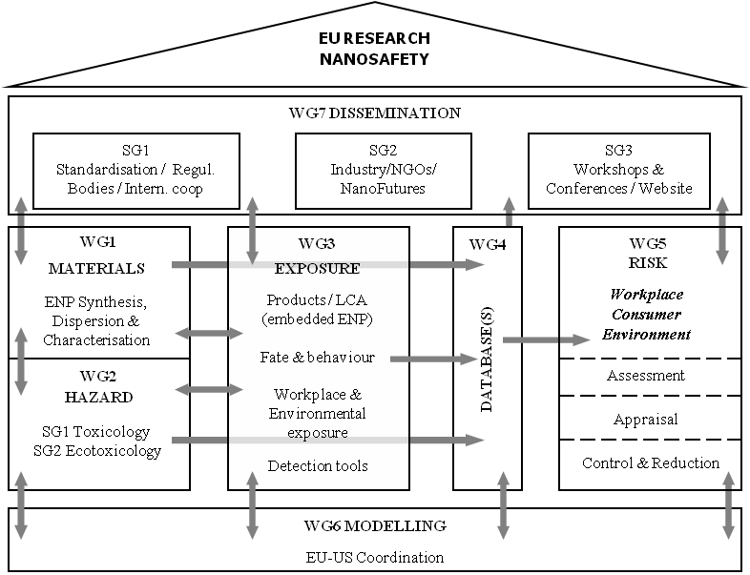
Coordinated by
FP7 Marina
L Tran & J Scott-Fordsmand
http://www.marina-fp7.eu/
WG8 Systems Biology

Slide 6
Current status
Various projects focussing on this area
Agnes G. Oomen, Peter M. J. Bos, Teresa F. Fernandes, Kerstin Hund-Rinke, Diana Boraschi, Hugh J. Byrne, Karin Aschberger, Stefania Gottardo, Frank von der Kammer, Dana Kühnel, Danail Hristozov, Antonio Marcomini, Lucia Migliore, Janeck Scott-Fordsmand, Peter Wick, Robert Landsiedel (2013) Concern-driven integrated approaches to nanomaterial testing and assessment – report of the NanoSafety Cluster Working Group 10. Nanotoxicology (doi: 10.3109/17435390.2013.802387) http://informahealthcare.com/doi/abs/10.3109/17435390.2013.802387
Nanosafety Cluster (2013) Nanosafety 2015-2025: A Strategic Research Agenda towards Safe and Sustainable Nanomaterial and Nanotechnology Innovations. http://www.ttl.fi/en/publications/Electronic_publications/Nanosafety_in_europe_2015-2025/Documents/nanosafety_2015-2025.pdf
ITS Nano (2013) Research Prioritisation to deliver an intelligent testing strategy for the human and environmental safety of nanomaterials. http://www.its-nano.eu/
MARINA, ”Workshop to implement Exposure and Hazard in a Risk Assessment Strategy for Nanomaterials”, April 2013. Available for comments via http://www.marina-fp7.eu/publications/detail.php?we_objectID=81

Slide 7
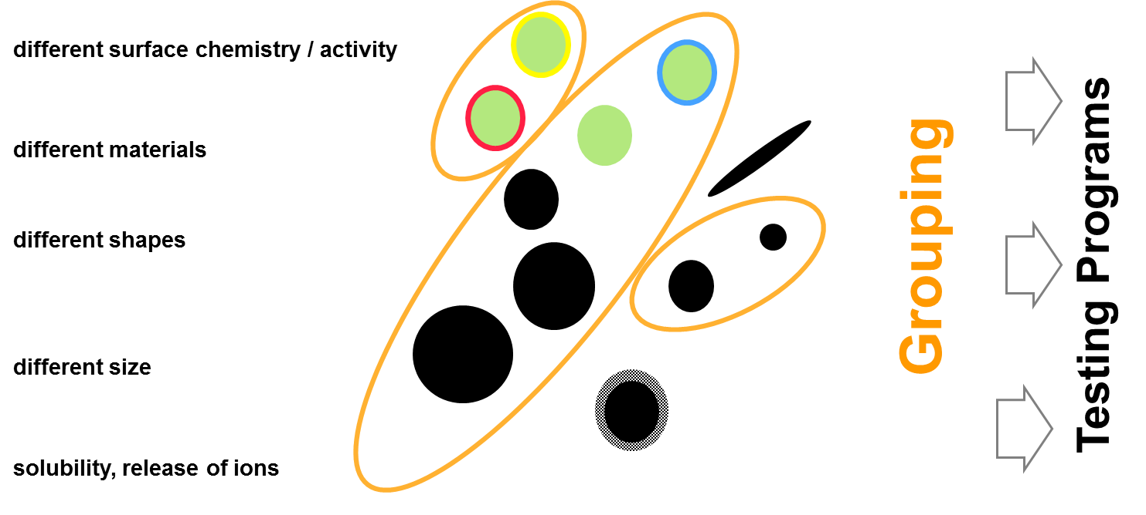
Grouping
NSC/Oomen et al 2013

Slide 8
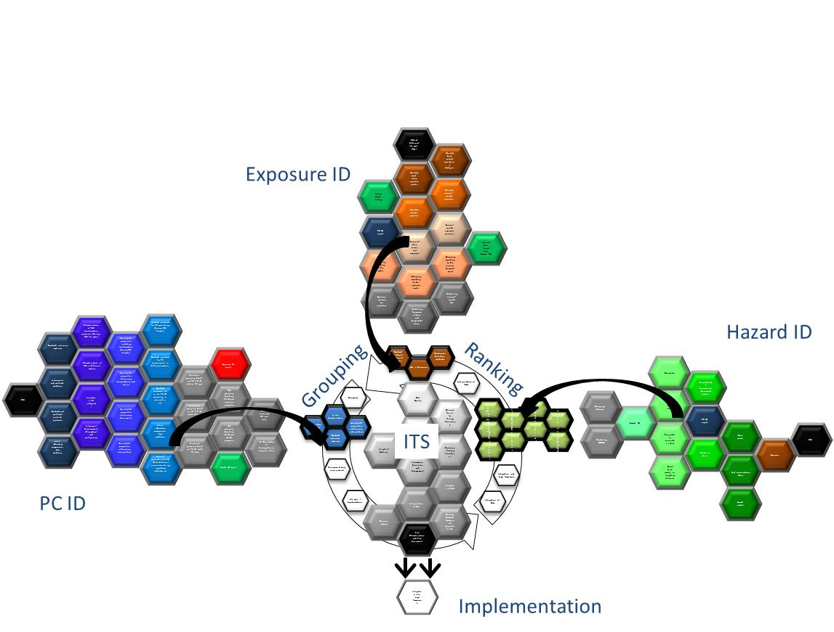
Integrating Research Priorities
http://www.its-nano.eu/
ITS NANO

Slide 9
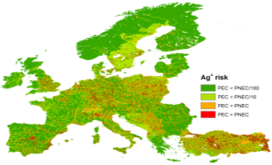
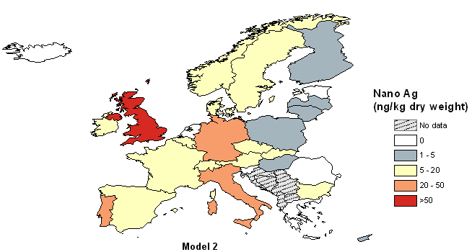


NanoFATE EU (2010-2014) Approach – Talk 300 Tuesday PM
Claus Svendsen
1) & 2) PECs:
Water:
Soil:
3) PNECs:
1) How much?
2-5x
2) Where does it go?
3) Will it cause effects?
  “Tools for mapping environmental risk across Europe from
  commercial nanoparticles used in consumer products”

Slide 10

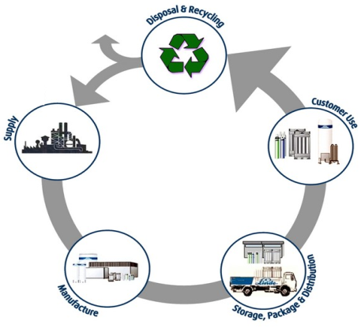
SUN (Safety in Nanoscale Production and Products)
Combine Risk Assessment and Lifecycle Assessment to develop a user-friendly, versatile software-based Decision Support System (DSS) for practical use by industries and regulators
Evaluate and “reality-check” the DSS against real industrial case studies in terms of cost/benefit and insurance risk
Develop guidelines for safe product and process design
Risk and Lifecycle Assessment data and tools
Lifecycle perspective
Development of a Decision Support System (DSS)
Application/ testing of the DSS to case studies
Safe product/process design
Regulatory oversight
Cost-benefit
Insurance risk transfer
Research needs
Prof A Marcomini, Dr Danail Hristozov

Slide 11
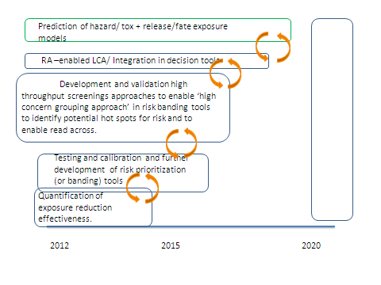
NSC - Risk prediction tools
Nanosafety Cluster (2013) Nanosafety 2015-2025: A Strategic Research Agenda towards Safe and Sustainable Nanomaterial and Nanotechnology Innovations. http://www.ttl.fi/en/publications/Electronic_publications/Nanosafety_in_europe_2015-2025/Documents/nanosafety_2015-2025.pdf

Slide 12



Idealized Information-to-Action Continuum
Use risk assessment input to weigh trade-offs in context of alternatives and take action to minimize risks.
Risk Management CoR
Synthesize hazard and exposure research, filter and interpret to arrive at risk forecasts of ENMs.
Risk Assessment
CoR
Draw on emerging and increasingly organized data sources to model potential exposure, transformation, biouptake, and ecological and human health impacts.
Exposure Modeling CoR
Ecotox Testing and Modeling CoR
Human Health Modeling
CoR
Subsume and organize all emerging nanomaterial data and metadata to provide hazard and exposure modelers with rich, integrated data sets.
Ontologies and Databases
CoR
Christine Hendren & Mark Hoover

Slide 13



Idealized Information-to-Action Continuum: Exposure x Hazard = Risk
Action
Use risk assessment input to weigh trade-offs in context of alternatives and take action to minimize risks.
Risk Management CoR
Synthesize hazard and exposure research, filter and interpret to arrive at risk forecasts of ENMs.
Risk Assessment
CoR
Risk
=
Draw on emerging and increasingly organized data sources to model potential exposure, transformation, biouptake, and ecological and human health impacts.
Exposure Modeling CoR
Ecotox Testing and Modeling CoR
Human Health Modeling
CoR
Exposure
X
Hazard
Subsume and organize all emerging nanomaterial data and metadata to provide hazard and exposure modelers with rich, integrated data sets.
Ontologies and Databases
CoR
Information
Open Literature
Christine Hendren & Mark Hoover

Slide 14
Next steps
Preparation of upcoming US-EU nano-EHS workshop (Arlington, 2-3 December 2013) (within-between CoR meetings)
Focus on selection of key prioritized issues from EU/ US strategy reports for further consideration
Continue cross-CoR dialogue

