Slide 1
The Need for International Harmonization of nanotechnology Laws
By Ilise L Feitshans JD and ScM
Visiting Scientist and Scholar in Law of Health. Institute for Work and Health (IST)University of Lausanne,
Doctoral Candidate in International Relations
« Forecasting Nano Law: Risk Management Protecting Public HealthUnder International Law »
Geneva School of Diplomacy, Geneva Switzerland.
EmailIlise.Feitshans@chuv.ch or forecastingnanolaw@gmail.com
tél. +41 79 836 3965 USA 917 239 9960

Slide 2
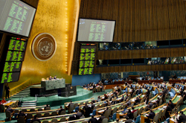
Emerging Laws of Nanotechnology
UN General Assembly, New York City, Aug 2006, passing the UN Convention on the Prevention of Discrimination Against Persons With Disabilities.
What is the future for a UN Convention on nanotechnology?

Slide 3
Defining the Issue Nanotechnology and Risk
Nanotechnology - The Challenge
Does the nature of engineered nanostructured materials and devices present new safety and health risks?
How can the benefits of nanotechnology be realized while proactively minimizing the potential risk?

Slide 4
Discussion Objectives
Understand:
Where we are under law.
How law is created.
Where the law may go.
Cultivate:
NANOINFORMATICS to foster good law (consistent, predictable, workable).
Good law to foster innovation.

Slide 5
Inputs to Law
Insight
Law

Slide 6
Inputs to Law
Vested Interests
Vested Interests
Law
Vested Interests
Vested Interests

Slide 7
Ideal Input to Law
Law
Implications
Science

Slide 8
Sound occupational health programs
implement best strategies are the grease for the machinery of powerful economic engines
Occupational heath programs help employers survive because accidents and disease are not simply expensive but wasteful.

Slide 9
OBJECTIVE
NECESSITY OF AN OCCUPATIONAL HEALTH COMPLIANCE PROGRAM
Avoid liability
Reduce lost productivity and down-time;
Avoid ADMINISTRATIVE fines and penalties; and
Prevent injury.
In addition, workers' compensation systems also provide financial incentives for preventing occupational accidents, occupational diseases and some forms of gradual injury, such as occupational deafness, back injuries and carpal tunnel syndrome. For this reason in-house occupational safety and health compliance programs serve two major functions: providing clear evidence of an enterprise's commitment to obeying the law, while identifying hazards in time to reduce costs and potential liability.

Slide 10
DUE DILIGIENCE INTERNAL SYSTEMS TO LISTEN TO COMPLAINTS BEFOEE THEY BLOSSOM INTO MAJOR PROBLEMS LISTEN TO STAFF IN HOUSE INTERACT WITH AGENCY REGULATORS BEFORE PROBLEMS ARISE
AREAS FOR PROGRAM EMPHASIS

Slide 11
Hierarchy of controls the basic bricks for due diligence
1. Eliminate or minimize risks at their source;
2. Reduce risks through engineering controls or other physical safeguards;
3. Provide safe working procedures to reduce risks further, and
4. Provide, wear and maintain personal protective equipment.

Slide 12
UNPRECEDENTED!
GHS will bring together consumers, suppliers, end-users and manufacturers of toxic chemicals as never before

Slide 13
Advantages of Harmonization
Best practices
Shows due diligence
Predictability for commerce
Consistency that prevents conflicts of laws

Slide 14
Competing Laws
Law
Implications
Science

Slide 15
WHO
OECD
WHO
ISO… not a government
European Union
USA
China
South Africa
India
NATO
Think tanks
Is doing or influencing nano law?
Some
KEY PLAYERS

Slide 16
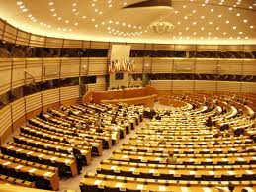
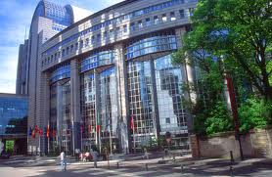
European Legislation (EU)
27 countries
Collective will Political will
Legislature exercises power

Slide 17
WHOM ARE THE NATIONS OF THE EU???
DEFININITION UNCLEAR
THIS IS IMPORTANT FOR QUESTIONS OF JURISIDICTION
FOR QUESTIONS OF CONFLICTS OF LAWS
27 NATIONS
SEVERAL PROVISIONAL MEMBERS
FLOATING MEMBERS LIKE Switzerland
Who can pick and choose when to participate
When to fund
AMBIGUITY UNDER LAW

Slide 18
Everybody Knows.. EU major efforts
Each nation has their own nanotechnology
Programs
Plus
New EU- USA ACCORDS
NanoImpact Net
QNANO
Nanosafety Cluster
EU Comission
JRC
Major Multinational Legislation

Slide 19
Does Europe speak with one voice?
Yes twice !!
European Union
Council of Europe

Slide 20
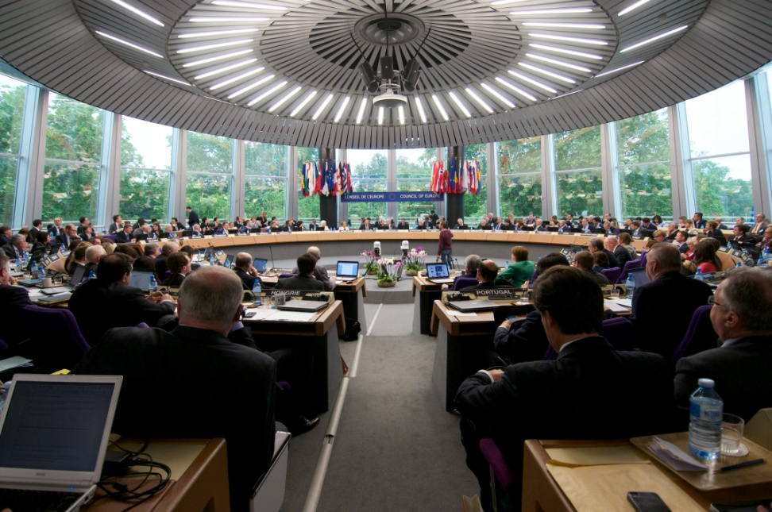
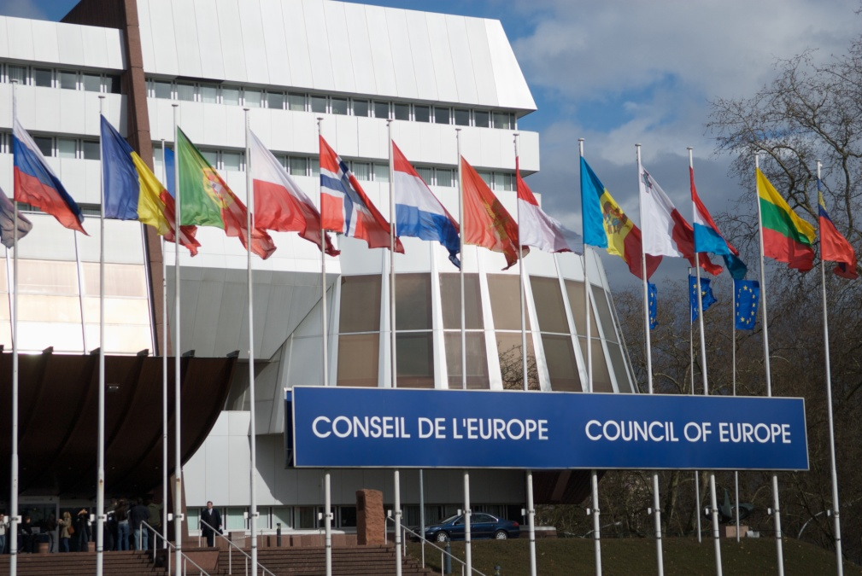
Council of Europe (COE)
47 countries
The Council of Ministers
The Parliamentary Assembly
The Congress
The Conference of International NGOs
The European Court of Human Rights

Slide 21
Role protecting consumer health
Within the rubric of individual rights to protections under European human rights law
-- Court
-- Reports and investigations
oversight for medical care
consumer rights
Genetically modified food
Can hear complaints against governments

Slide 22
Council of Europe Interest in Nano regulations
Survey of the law
Protect human rights in health care
Protecting the Human right to Health (valid under European law)
Protect human rights of consumers
Counterweight to “big corporations”

Slide 23
RECOMMENDATION 1- Possible role for the Council of Europe Defining OR regulating nanotechnology in its 47 member states
Plenty of laws exist already
GAPS in Two major areas:
1.Harmonization and
2. Consumer Education

Slide 24
Recommendation 2 Possible role for Committee of Ministers
Commission evaluating economic political scientific and legal aspects to determine-
or should there be a Convention developed on a "nanotechnology and human rights/health“
or possibly a Protocol to an existing Council of Europe Convention such as the Oviedo Convention on Biomedicine and Human Rights?
(Convention can be open to ratification by non-member states, like the Cybercrime Convention which binds the USA)

Slide 25
Recommendation 3 Proposed Report for the Proposed Study Commission regarding Nanotechnology
if such a Council of Europe-level recommendation (guidelines) or even a binding legal instrument were recommended,
Definitions: which criteria to apply for defining nano
Precautionary principle how respected, in which way?)
what could be the role of the Council of Europe's Parliamentary Assembly?
How best to participate in global discourse:
harmonise laws at national level while pushing for Council of Europe (or other institution)

Slide 26
Nanotechnology Risk Management & Control
OEHS Program Certification - A Due Diligence Approach
nOMS Certification Program
Executive Overview
Advisory Panel
nanoTox
Harmonized Nanotechnology OEHS Standards
Academy Training Programs
Certification Community
Auditor Certification
Nanotechnology OEHS Management Program Certification

Slide 27
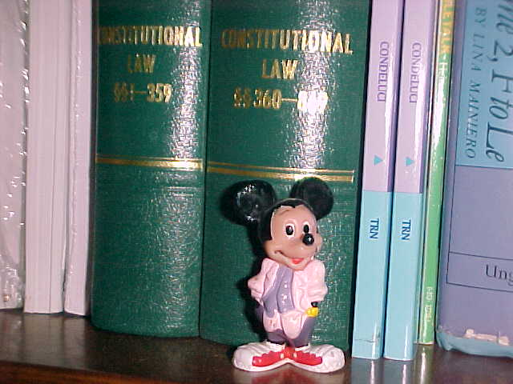
Proactive Opportunities
Educate yourself about the possibility of new laws, as well as existing laws.
2. Be clear in your goals about the scope and definitions in new laws.
3. Think through existing drafts.
4. Participate as an informed stakeholder.
5. Enjoy your role when
HAVING YOUR SAY!

Slide 28
Acknowledgements

Slide 29
Prof Ilise L Feitshans JD and ScM
forcastingnanolaw@gmail.com
AUTHOR DESIGNING AN EFFECTIVE OSHA COMPLIANCE PROGRAM
VISITING SCIENTIST
INSTITUTE FOR WORK
AND HEALTH (IST)
UNIVERSITY OF LAUSANNE, SWITZERLAND
DOCTORAL CANDIDATE AND Professor of international relations, “FORECASTING NANO LAW: RISK MANAGEMENT PROTECTING PUBLIC HEALTH UNDER INTRNATIONAL LAW”
Geneva School of Diplomacy

